Slide 1


Master Thesis ​
Deep Learning Models for X-ray Image Classification
​
Advisor :​
Prof. Nicola Adami​
​
Graduate:
Pentapati Avinash ​
Matricola : 726100
Master’s Degree in Communication Technologies and Multimedia​
​
Department of Information Engineering ​
Telecommunication section​
14th September 2022 ​

Slide 2
02
03
OBJECTIVES
METHODOLOGY
04
05
RESULTS ANALYSIS
CONCLUSION
FUTURE WORKS
01
INTRODUCTION

Slide 3
INTRODUCTION
Chest x-ray is the most important diagnostic technique for physicians. It helps diagnose and treat a wide range of diseases, such as:
Pneumonia​
Lung Cancer ​
Heart Failure and other Heart problems ​
Emphysema ​
Other medical conditions(Tuberculosis, Covid19 etc.,)

Slide 4
—Denis Waitley
“Time and health are two precious assets that we don’t recognize and appreciate until they have been depleted.”

Slide 5
02
OBJECTIVES
Problem statement & Objective

Slide 6
Problem statement
Some models are available that take care of only 1 diseases. In this manner, there is a necessity to bring up another model that can recognize more than one disease(Tuberculosis, Covid19, Pneumonia).
The objective of the thesis is to use the X-ray to analyze the condition of the patient and detect any kinds of anomalies that can lead to the Lung diseases at an early stage.

Slide 7
03
Methodology

Slide 8
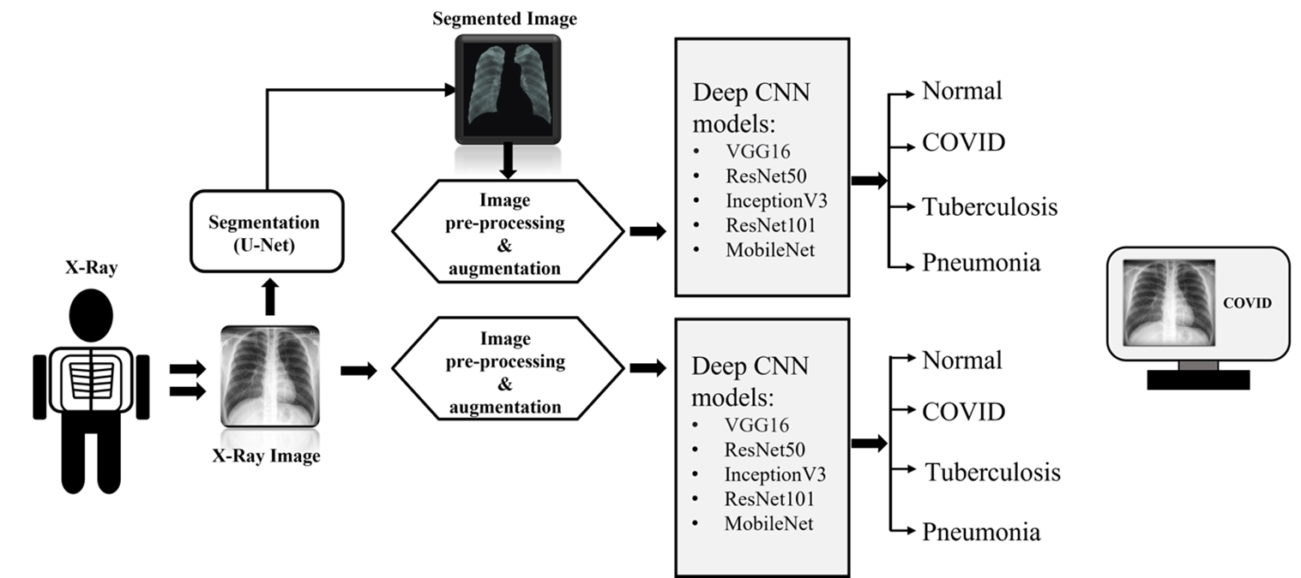
METHODOLOGY

Slide 9
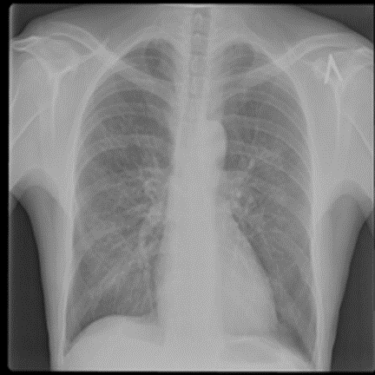
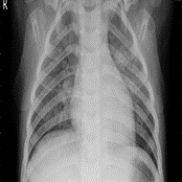
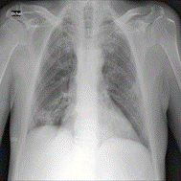
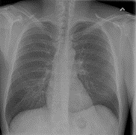
Sample X-ray Images for each class
Fig: Tuberculosis
Fig: Pneumonia
Fig: Covid19
Fig: Normal

Slide 10
Dataset Description​
In this work, we used a dataset which is a combination of three different datasets collected from Kaggle.​
We used 2835 total images in this project for all four classes, which is showcased in the below table.​
Original Dataset | Class type​ | Total no.of X-ray images | Train | Validation | Test
Mendeley Data | Pneumonia | 700 | 400 | 100 | 200
NLM, Belars and NIAID | Tuberculosis | 700 | 400 | 100 | 200
Covid19 Radiography Database | Covid19 | 700 | 400 | 100 | 200
All | Normal | 735 | 408 | 102 | 225

Slide 11
Experiment
The experiment has been performed in two approaches.
The first approach concerns the training of a neural network from scratch.
The second approach takes advantage of pretrained models that are fine tuned to specialize the model on the task of interest. In this case, transfer learning, the part of the pretrained network performing feature extraction are kept while only the last stages, operating the classification are trained.
We compare the results.

Slide 12
04
Results

Slide 13
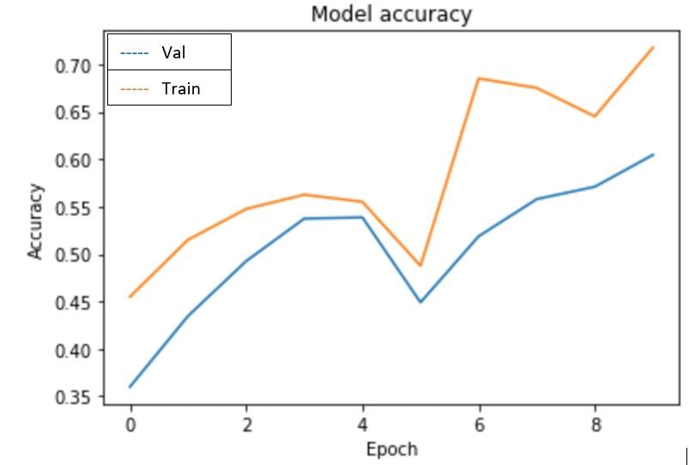
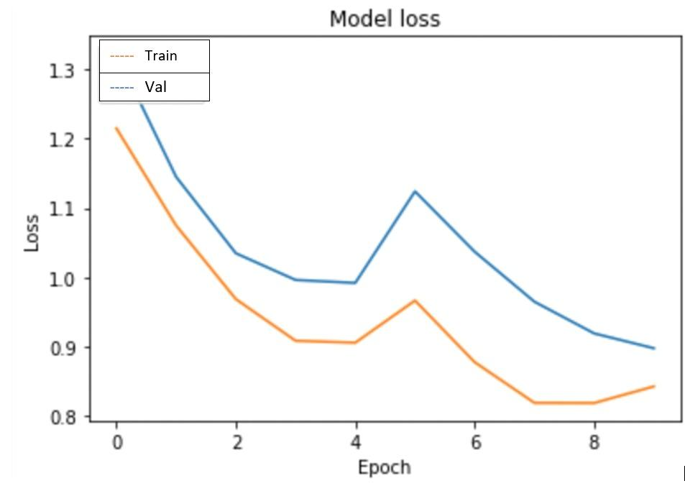
RESULTS ANALYSIS
CNN results are shown below.
List of Hyperparameters we used ​​
Epochs = 10, Batch-Size = 32, Optimizer = Adam , Loss Function = Categorical CrossEntropy,
Activation Functions = (ReLu, SoftMax ), Learning-Rate = 0.001.​

Slide 14
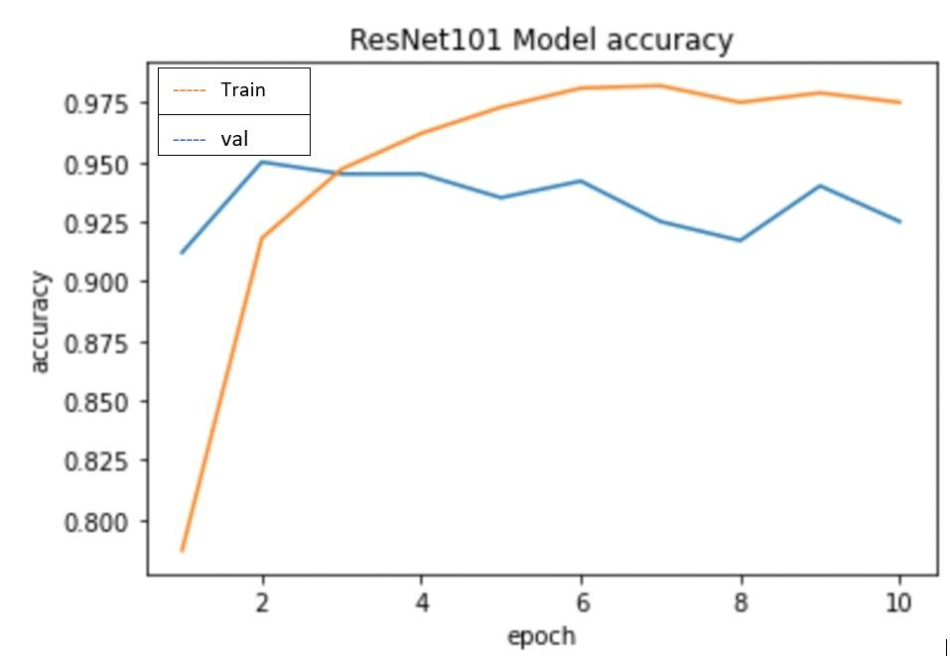
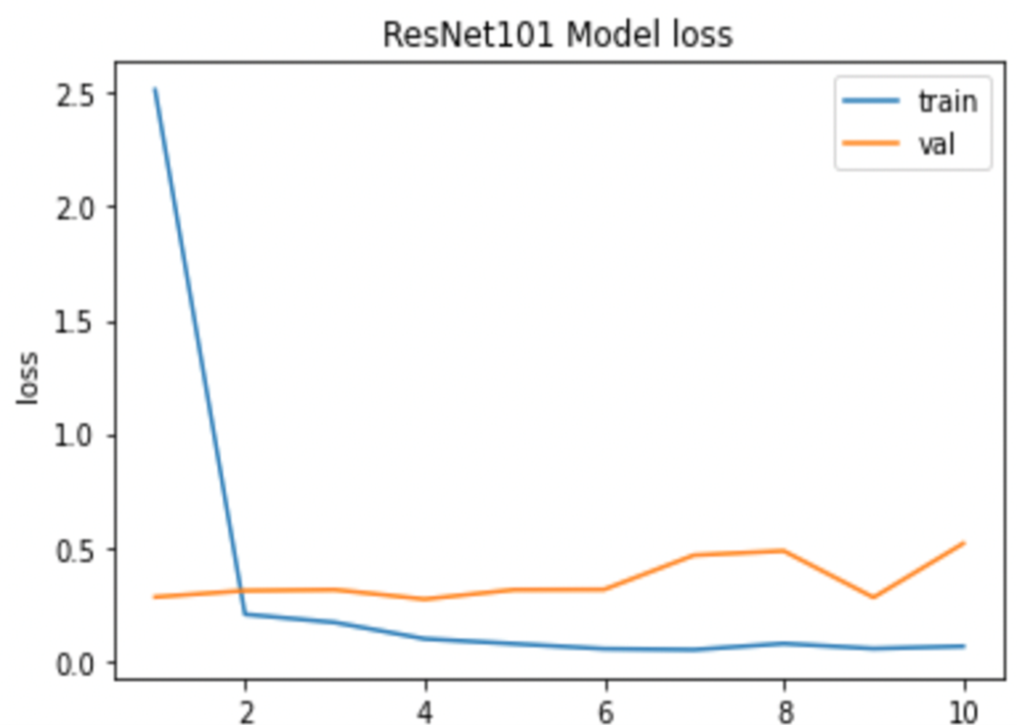
ResNet101

Slide 15
Performance Matrix
Accuracy is defined as the percentage of correct predictions for the test data. It can be calculated easily by dividing the number of correct predictions by the number of total predictions.
Accuracy = (T P + T N) (T P + F N)/(F P + T N)
Recall is defined as the fraction of examples which were predicted to belong to a class with respect to all the examples that truly belong to the class.
Recall = T P/(T P + F N)
Precision is defined as the fraction of relevant examples (true positives) among all the examples that were predicted to belong in a certain class.
Precision = T P/(T P + F P)
Specificity = T N/(F P + T N)
F1 Score = 2 *((Precision* Recall)/(Precision + Recall))
Here, true positive (TP), true negative (TN), false positive (FP), and false negative (FN) are used.

Slide 16
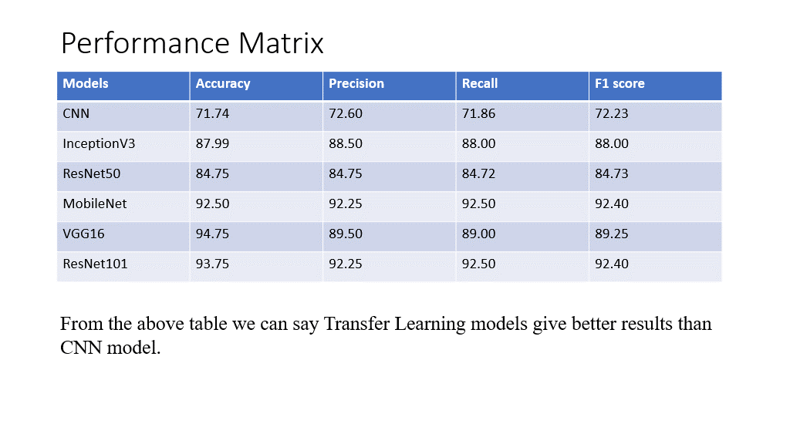

Slide 17
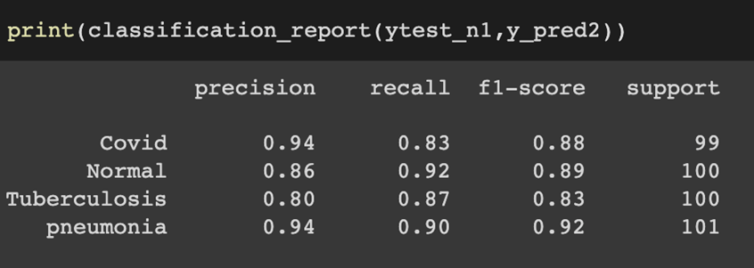
Classification Report
As an example. I am showing inceptionv3 Classification report below.

Slide 18
05
Conclusion
Conclusion & Future works

Slide 19
CONCLUSIONS
In this thesis, I implemented a good CNN (Convolution Neural Network) which can be trained and tested to identify which x-ray image belongs to which type of disease. After that, I used transfer learning with the same data on different pre-trained model to see which model gives the better performance.
The empirical evaluation, CNN performance analysis, and final findings can be generalized to the design of high-performance CAD systems for other medical imaging tasks.

Slide 20
Future Works
In continuation of the work already done, we strongly suggest that a further study can be performed on segmentation.
I advise anyone interested in this project to expand it and include the following benefits:​
Get the best and most comprehensive dataset for all four classes.
To improve the classification results, obtain the masked data for each of the four classes to do segmentation. ​
Use visualization techniques to see network decision making.

Slide 21


